Slide 1

Inductor Machine
Shu jun Cao
San chong Ng
Hai zhou Hua
Jin Liu

Slide 2
Context
The Background of inductor machine
The structure of inductor machine
The principles of inductor machine
The mathematical model of inductor machine
The application of inductor machine

Slide 3
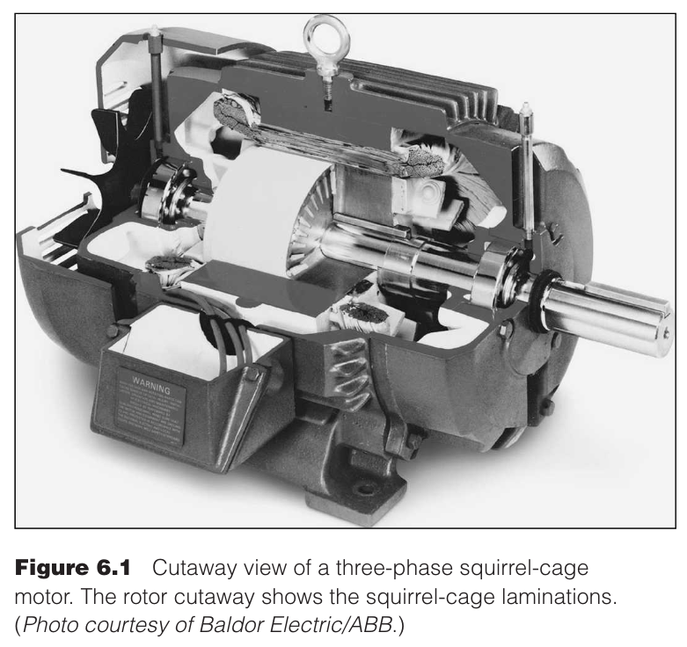
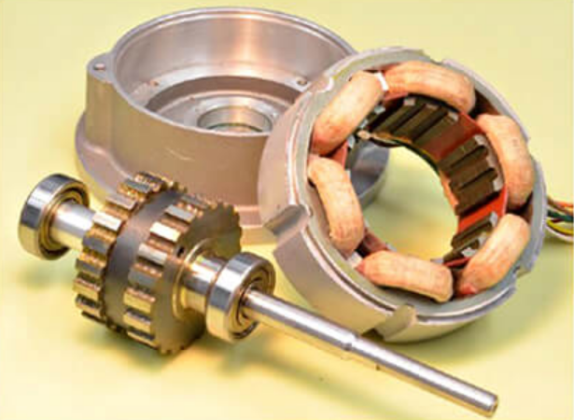
The Background of Inductor Machine
For traditional AC induction motor
Complicated windings, commutators or brushes
Few application scenarios-High Energy Physics Experiment
Notes:
高能物理實驗电流通常更高

Slide 4
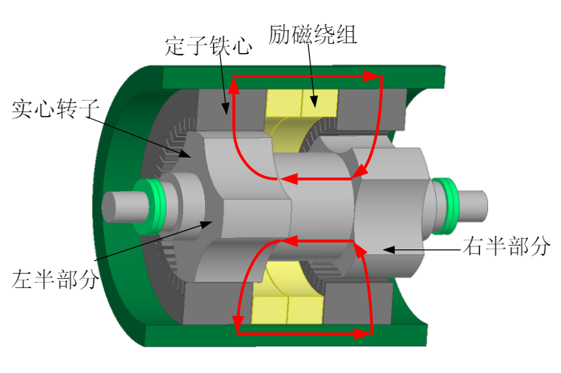
The Structure of Inductor Machine
Special stator-rotor construction
The rotor is made of high-quality steel
The excitation winding is placed on the stator
The stator core adopts the non-toothed slot structure
Electromagnetic levitation and vacuum technology is essential
Notes:
The rotor is made of high-quality steel to ensure that the rotor will not be disintegrated because of the high linear velocity of the edge during high-speed movement
the excitation windings are placed on the stator and the cooling is simple, using the copper pipe heat conduction and water cooling, therefore it can has a larger excitation power, which is conducive to improving the power density of the motor;
the stator core adopts the non-toothed slot structure to eliminate the space harmonic magnetic field produced by the slot, thus greatly reducing the rotor eddy current loss.
The stator core adopts non-slotted structure, which eliminates the space harmonic magnetic field generated due to the core slotting, and thus can greatly reduce the rotor eddy current loss.
Induction sub-motor rotor to maintain sustained high-speed rotation, reduce mechanical friction and wind resistance, electromagnetic levitation and vacuum technology is essential!

Slide 5
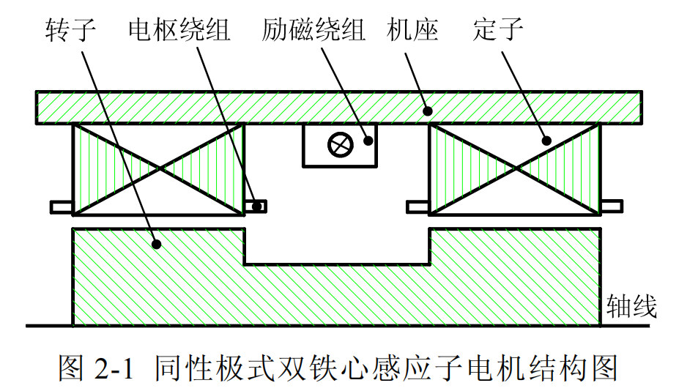
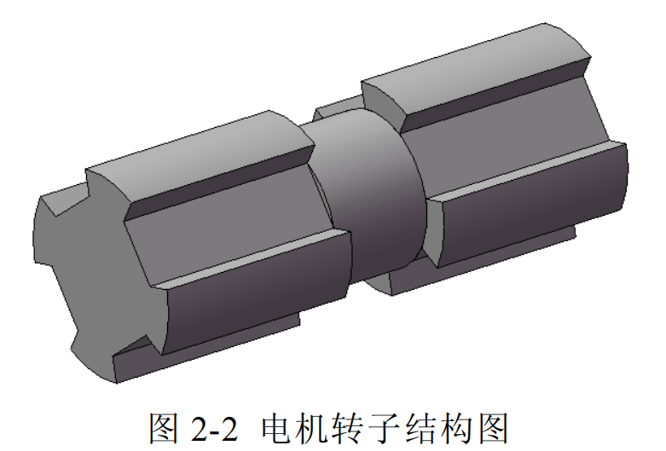
Operating Principle
Generator:
The magnetic permeability of the tooth and slot of the inductor (rotor with slot) is different, the air gap flux density on the tooth is higher, and the flux density of the slot is lower.

Slide 6
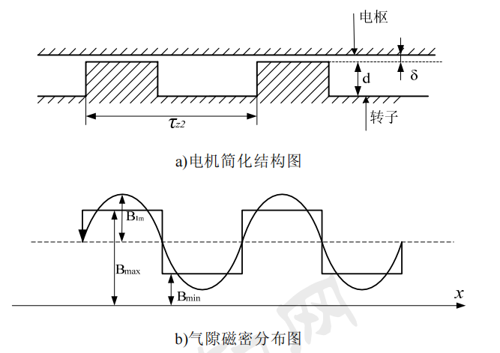
Operating Principle -- Generator
When the inductor rotates, the flux of the stator armature winding pulsates periodically, thus generating induced electromotive force (emf) in the winding.

Slide 7
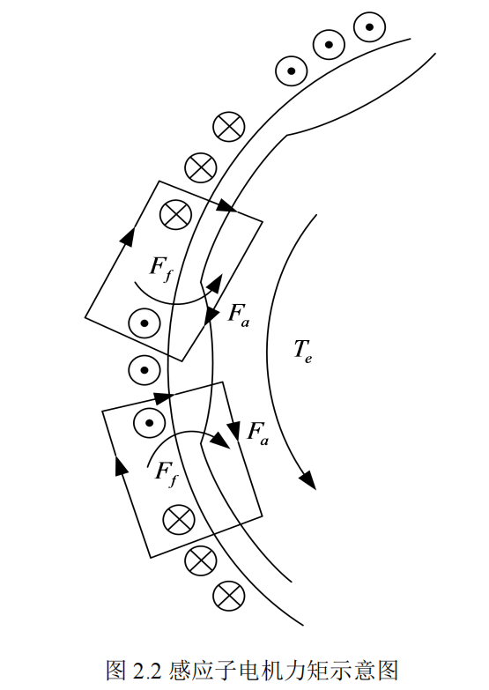
Operating Principle - Motor
The rotor tooth can be regarded as a magnetic pole and the rotor slot as a magnetic pole relative to the airgap fundamental magnetic field.
The magnetic field generated by the field winding is cross-linked with the alternating magnetic field generated by the armature winding, which causes different forces on different slot walls of the rotor.

Slide 8
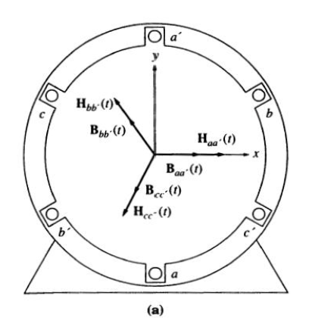
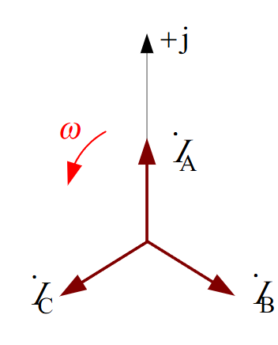
Armature Reaction

Slide 9
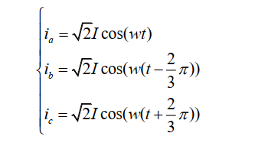

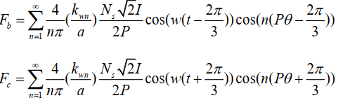

Armature Reaction

Slide 10
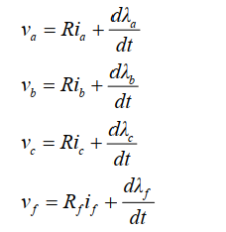
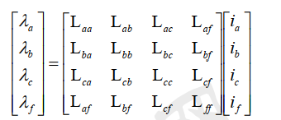
Armature Reaction

Slide 11
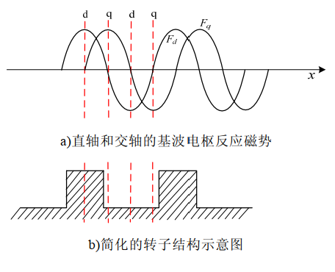
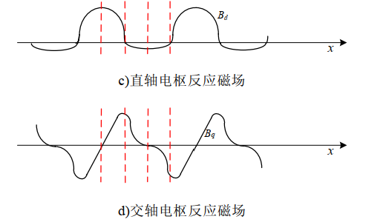
Armature Reaction

Slide 12
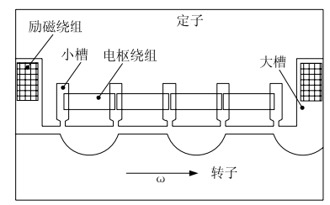
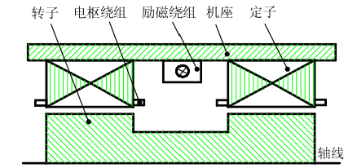
Classification
homopolar inductor machine
heteropolar inductor machine

Slide 13
Classification
Compared with the homopolar type, the heteropolar type has some disadvantages:
1. limited speed
2. reducing the use of space of stator
3. a large rotor iron loss

Slide 14
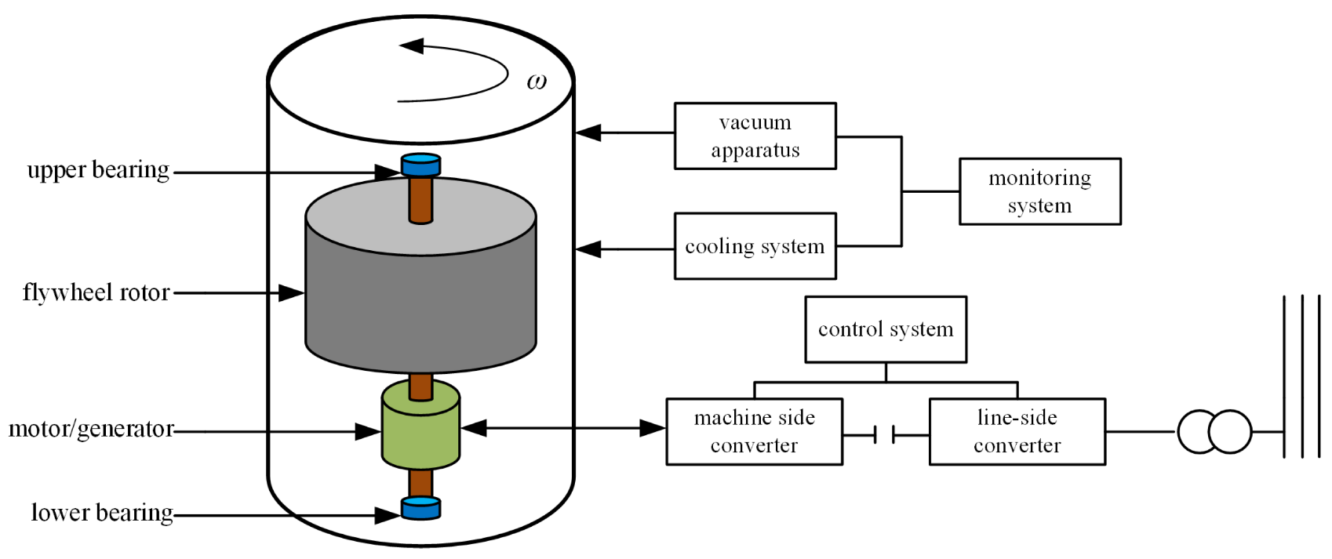

Application of inductor machines
Flywheel Energy Storage
Inductor machines
Omitted structure
Simple cooling
High rotation speed
Low-speed (typically 10,000rpm)
high-speed (up to 100,000rpm)
Notes:
由于励磁绕组置于定子上，省去了滑环结构，提高了系统运行的可靠性。励磁绕组的冷却简单，放置空间大大增加，因此可以获得较大的气隙磁通密度。转子可采用高强度实心钢，适合高速旋转。Because the excitation winding is placed on the stator, the slip ring structure can be omitted, the reliability of the system operation is improved.
The cooling of the excitation winding is simple, and the placement space is greatly increased, so a large air gap flux density can be obtained.
The rotor can be made of high strength solid steel, suitable for high-speed rotation.

Slide 15
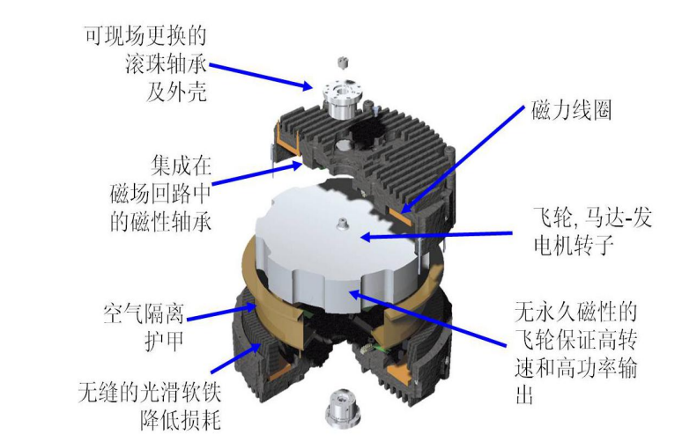
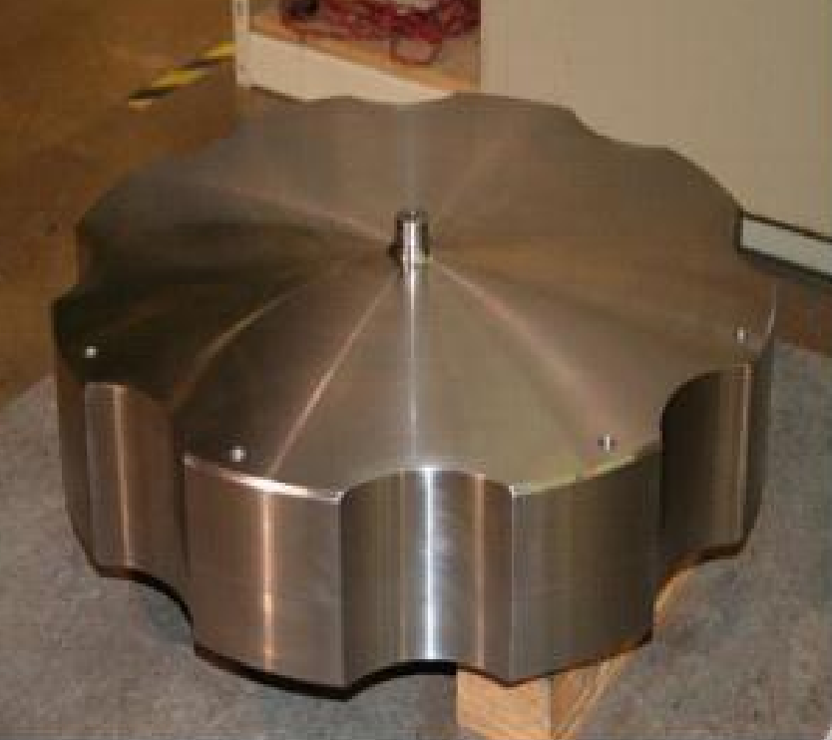
Application of inductor machines
Flywheel Energy Storage
The Flywheel battery’s profile of Active power company
Notes:
感应子电机相对于异步电机和同步电机,现有的文献对其研究较少,尤其是感应子电机转子齿槽形状和槽深对气隙磁场的影响规律还有待进一步探索。Compared with induction motor and synchronous motor, there are few literatures on induction motor, especially the influence of rotor groove shape and groove depth on the air gap magnetic field needs to be further explored.如果在仅改变感应子电机转子齿槽形状和槽深的前提下,就可以优化电机结构,提高电机性能,那么将会产生很大的经济效益和电机的整体性能的优化。If the motor structure can be optimized and the motor performance can be improved under the premise of only changing the shape and depth of the rotor groove of the induction motor, it will produce great economic benefits and the optimization of the overall performance of the motor.

Slide 16
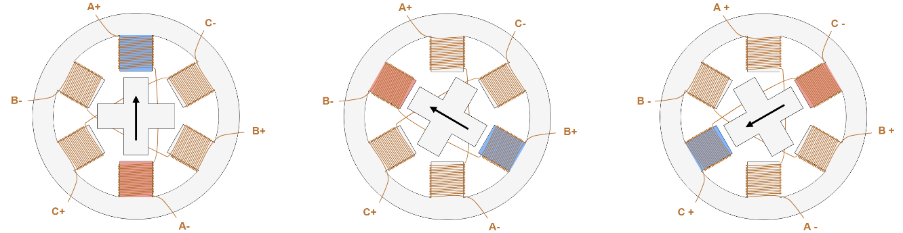
Application of inductor machines
Stepping motors
Notes:
步进电机是一种将电脉冲信号转换成相应角位移或线位移的电动机。Stepper motor is a kind of motor that converts the electrical pulse signal into the corresponding angular displacement or linear displacement.
每输入一个脉冲信号,转子就转动一个角度或前进一步,其输出的角位移或线位移与输入的脉冲数成正比，转速与脉冲频率成正比。Each input pulse signal, the rotor rotates an Angle or further forward, the output angular displacement or linear displacement is proportional to the number of input pulses, and the speed is proportional to the pulse frequency.
感应子电机的转子为可变磁阻铁芯,因此在脉冲电流的激励下,可以产生固定角度位移。The rotor of the inductor motor is a variable reluctance core, so it can generate a fixed Angle displacement under the excitation of the pulse current.

Slide 17
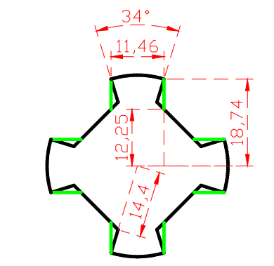
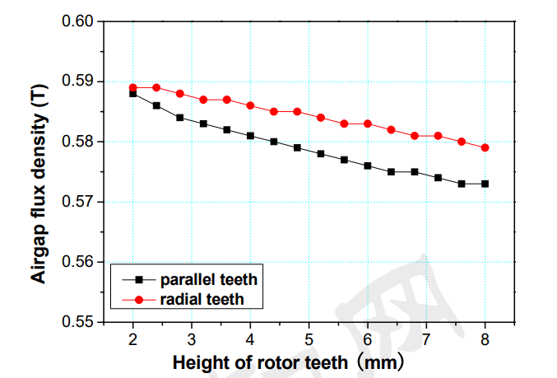
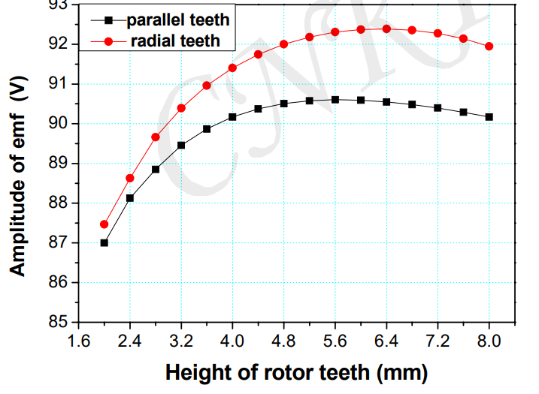
Problems
Effect of rotor groove depth on motor performance
Notes:
感应子电机相对于异步电机和同步电机,现有的文献对其研究较少,尤其是感应子电机转子齿槽形状和槽深对气隙磁场的影响规律还有待进一步探索。Compared with induction motor and synchronous motor, there are few literatures on inductor motor, especially the influence of rotor groove shape and groove depth on the air gap magnetic field needs to be further explored.
不同转子齿型感应子电机的气隙磁密上限值随转子槽深度值的增大略有减小。The upper limit value of air gap magnetic density of inductors with different rotor tooth types decreases slightly with the increase of rotor groove depth.
径向齿转子感应子电机的气隙磁密上限值较平行齿转子的大。The upper limit of air gap flux density of radial rotor inductor motor is larger than that of parallel rotor.
如果在仅改变感应子电机转子齿槽形状和槽深的前提下,就可以优化电机结构,提高电机性能,那么将会产生很大的经济效益和电机的整体性能的优化。If the motor structure can be optimized and the motor performance can be improved under the premise of only changing the shape and depth of the rotor groove of the induction motor, it will produce great economic benefits and the optimization of the overall performance of the motor.

Slide 18
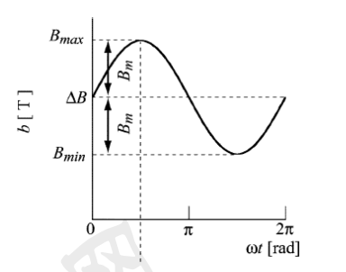
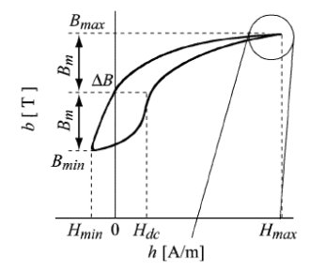
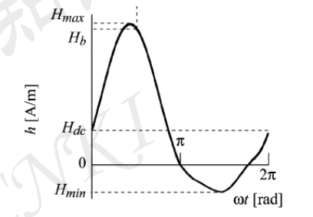
Problems
Influence of DC magnetic offset
flux density waveform
B-H curve
magnetic field intensity waveform
Notes:
由于直流偏磁的存在，磁通密度达到其正的最大值时将需要更 大的磁场强度，而在达到负的最大值时需要很小的磁场强度，因而将导致磁滞 回线的不对称，引起磁滞损耗的增加。因而铁心在直流偏磁激励下产生的损耗 大于在正弦波激励下产生的铁耗。
Due to the existence of DC bias, the magnetic flux density will need to be more when it reaches its positive maximum. A large magnetic field strength, while a small magnetic field strength is required to reach a negative maximum, will result in hysteresis. The asymmetry of loop leads to the increase of hysteresis loss. Therefore, the loss of the core under DC bias excitation is greater than the iron consumption produced under sine wave excitation.

Slide 19
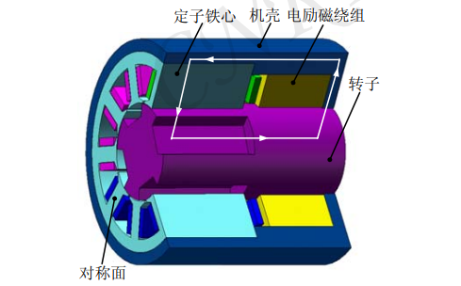
Summary
Feature : A free rotor
Principle : air gap flux density distribution
Advantages : stable, high-speed, simple cooling system
Problems : rotor groove effect and DC magnetic offset

